Slide 1
Week 1 Report
Jacob Lin
Week of 6/3 – 6/6

Slide 2
Summary
Explored the articles about GLM and ABI, learned some very general information on those.
Researched some resources to help with learning complex computer vision
Experimented with the provided test files given, and experimented with a real sample downloaded from GOES-R
Played around with OpenCV2’s key-points features for the key features of an image
Learned about feature detection

Slide 3
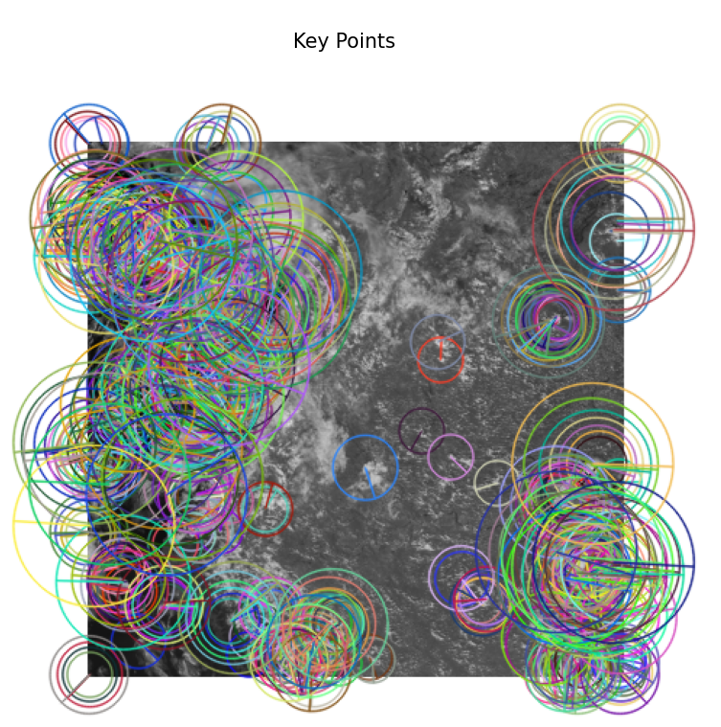
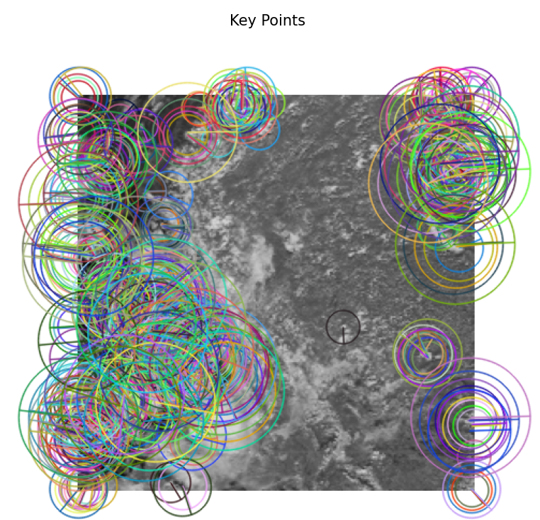
Playing around with CV2
Left is ABI, right is GLM
Concerns:
  Not the same pattern, it looks
  like they are almost flipped
  Probably not useful for ML/AI
  algorithms

Slide 4
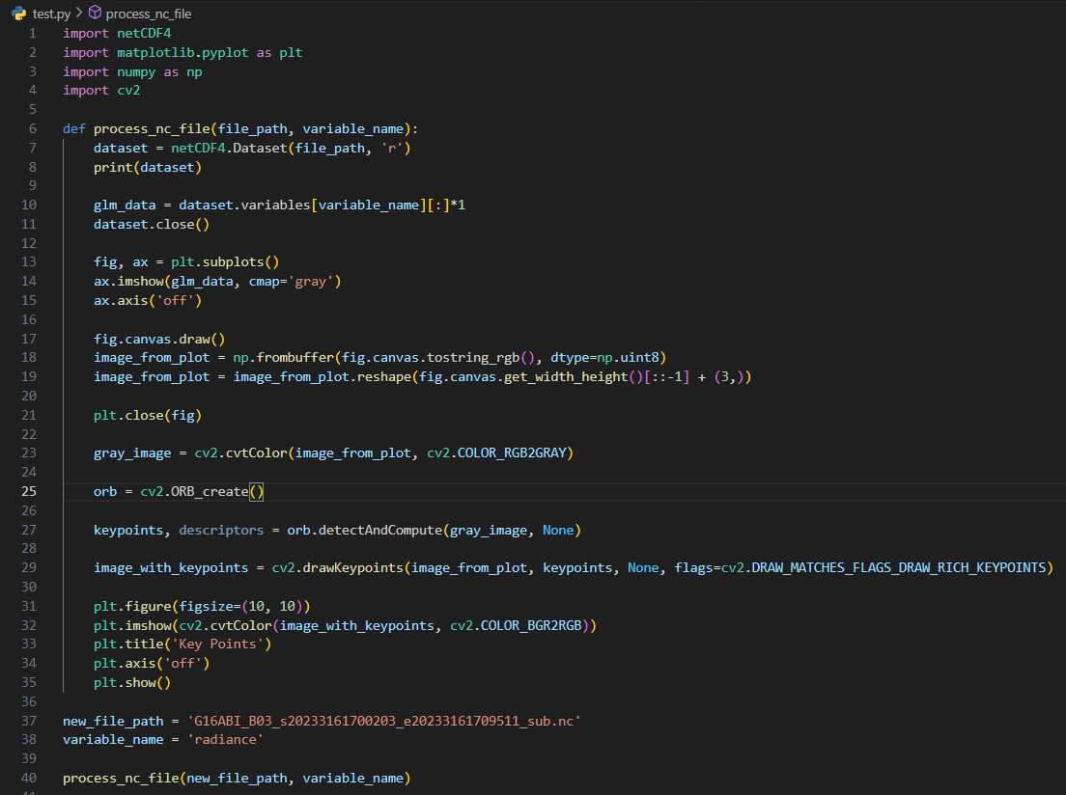
Code for previous slide

Slide 5
Idea for the project
Naïve idea:
  Scale either of the 2 images (up or down) then put them back to back near each other
  Subtract the images from each other, maybe use RGB values and such what to do so, create a loss function from that which takes each pixel’s RGB value and subtract it from the rest
  Make some sort of NN from that?
    Another idea, since we scaled the images, if we want to find the point on the ABI on the GLM, we can just scale the point on the ABI to the corresponding point on the GLM photo.

Slide 6
Questions
Is the data given as correct pairs of individual subsets of the main image or are they randomized subsets of each image?
Is the data given as a image or video?
Does the photo always have the south pole on the bottom and north on top?
Should we rely on complex mathematics or just simple ML/AI python libraries?
Codebase or repositories?
How to get the data in real time?
Any connections with people who may be knowledgeable in the field?

Slide 7
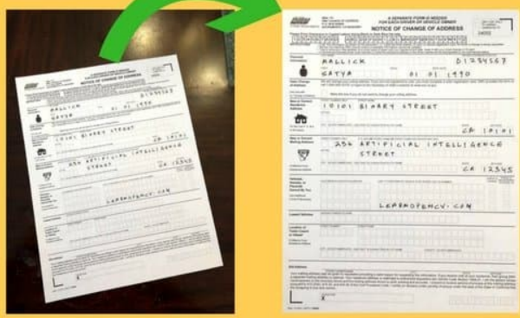
Resources
Feature Based Image alignment with OpenCV - https://learnopencv.com/image-alignment-feature-based-using-opencv-c-python/
  Great for nonuniform orientated photos
MIT Graduate course for Self-Driving Autonmous Vehicles
Feature matching in OpenCV2
General OpenCV documentation tutorial

Slide 8
Concerns and Blockers
Very high complex topics
High levels of mathematics, this is due to my weaker linear algebra skills, but higher analysis skill. (I focus on theorical math side)
Schedule layout
Slow computer for any large machine learning works
Need more guidance

Slide 9
Expectations/Goals for next week
By Monday:
  Do more research/learning
  Find examples of other image registrations applications
  Trying to find a very easy code for very simple image registation
By Friday:
  Try to understand the code from above
  Coming up with 1+ strong ideas (hopefully at least one idea)

